Slide 1
UX + Content Design Writing Samples
Nadia Ibanez
June 2021

Slide 2
The Ask +
The Challenge
As Covid-19 started taking a toll on our lives and daily activities, my team was asked to design and execute a simple solution for customers to digitally register for Commercial Electronic Office.

Slide 3
My Role
Determine content concepts to test/validate with customers
Collaborate with Product, Legal + Development
Execute Invision prototype, copy deck + lexicon

Slide 4
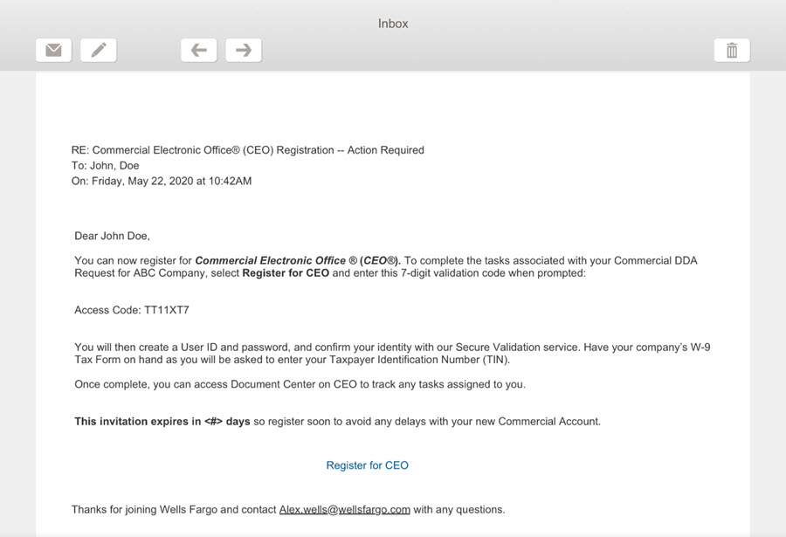
Discovery Email Concept

Slide 5
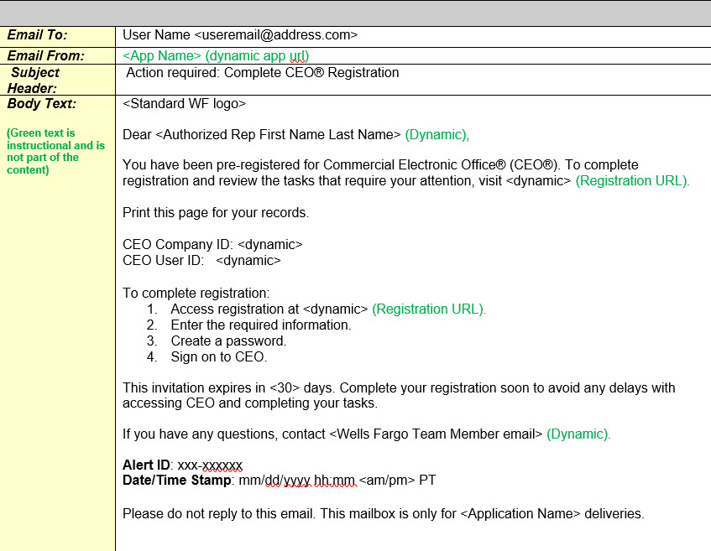
Actual Shipped Email

Slide 6
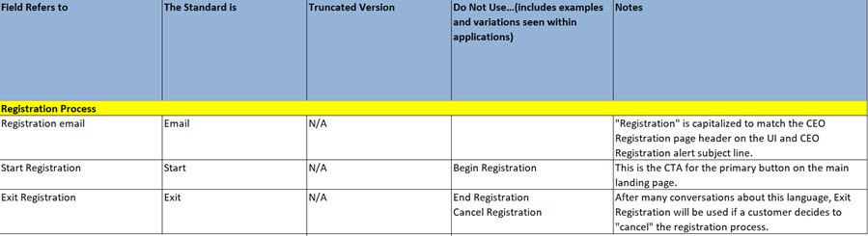
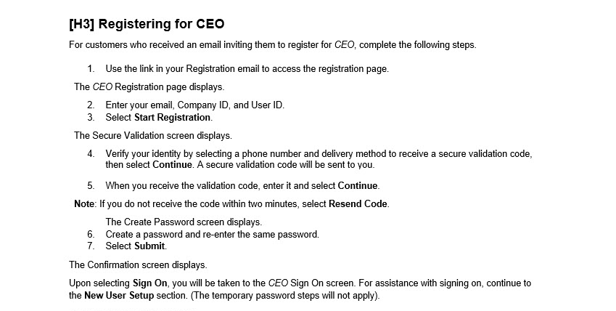
Content Deliverables

Slide 7
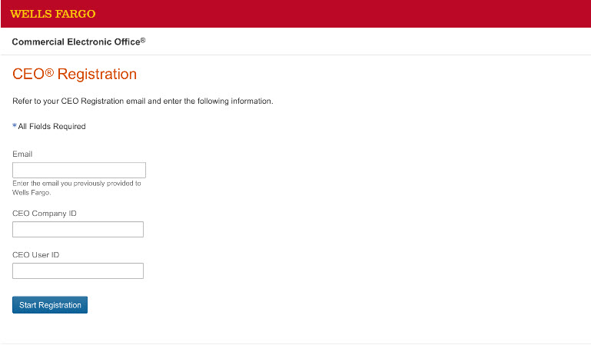
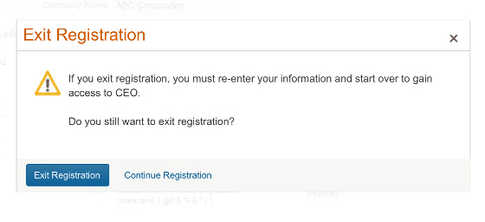
Shipped Flow

Slide 8
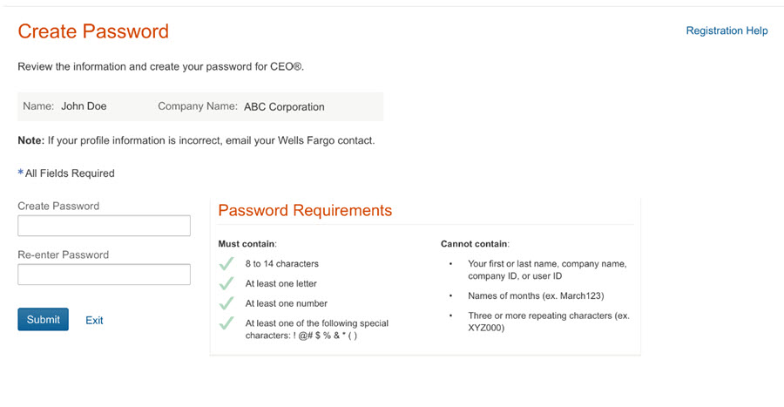
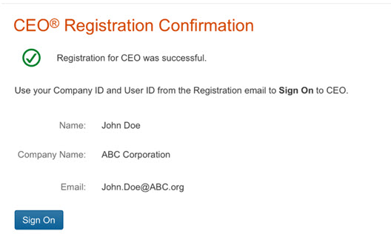
Shipped Flow con’t

Slide 9
Thank you!

