Slide 1
E-Sign, You Sign, We All Sign!
Discovery Work for Digital Collaboration
Nadia Ibanez
Content Writer, Editor, Storyteller
Content Strategist-in-Training
January 2020

Slide 2
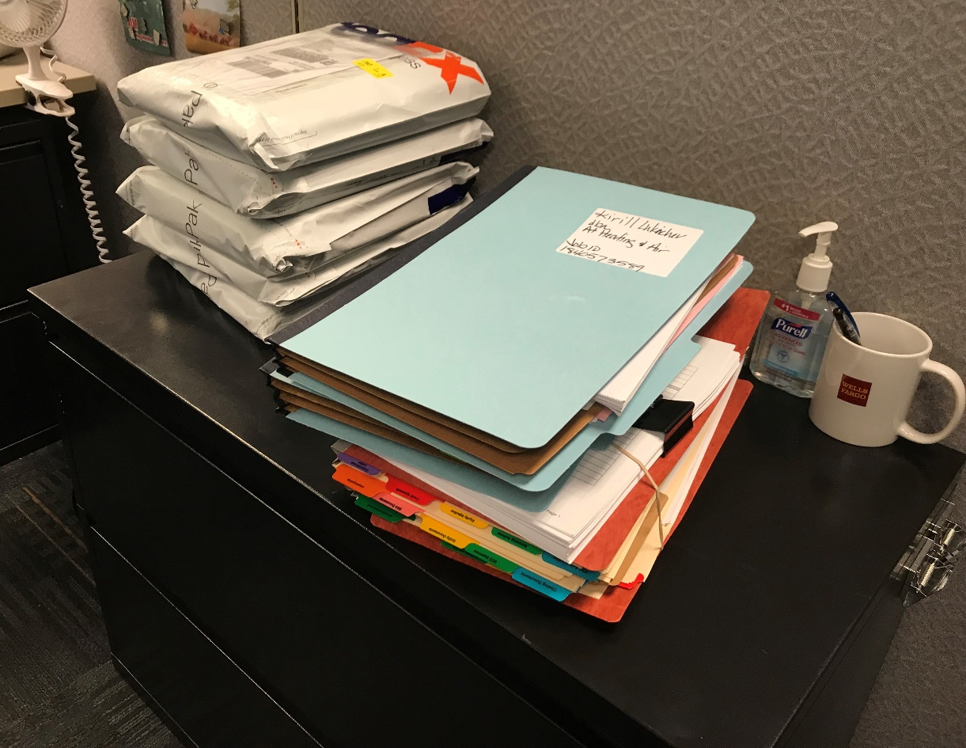
The Ask
How can CXD effectively design an E-Sign experience for CEO customers?
The functionality does not currently exist, but customers expect the feature to be intuitive, easy, informative, and similar to DocuSign.
Currently, customers use paper-heavy processes to review documentation and submit signatures to Wells Fargo team members.
Photo courtesy Nadia Ibanez,
Roseville 2018

Slide 3
Previous Research Told Us…
Existing customers are accustomed to faxing or completing documentation in-person (to submit wet signatures) with their Relationship Manager.
“Customers are delighted by seeing an e-sign feature but are concerned about coordinating between those signing electronically and the less tech-savvy signers who need a paper copy to sign.”
-- Tara Rohani, from Digital Collaboration Synthesis

Slide 4
User Research – Take One
E-Sign Flow on Invision
Findings:
Some customers still wanted to print the documents for later review, or to pass it along to a C-level exec within their company
Most customers were fine with the submit signature pop-up language
Customers started referring to the status bar for direction

Slide 5
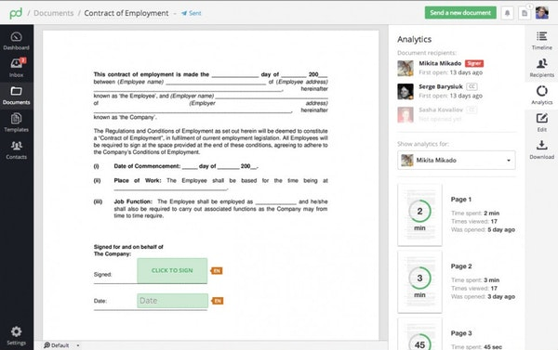
How We Evolved – Competitive Analysis
The Ask: How could we evolve our current solution to address multiple signer and signatures?
DocuSign Tutorial and PandaDoc

Slide 6
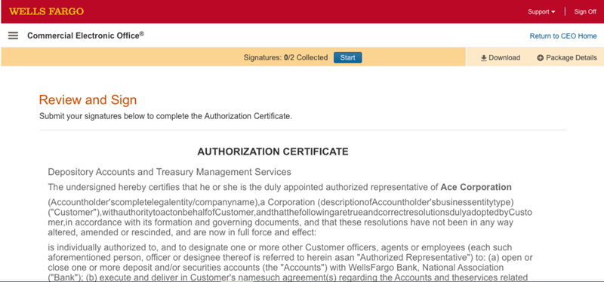
User Research – Take Two
https://wiswux.invisionapp.com/d/main#/projects/prototypes/18608893

Slide 7
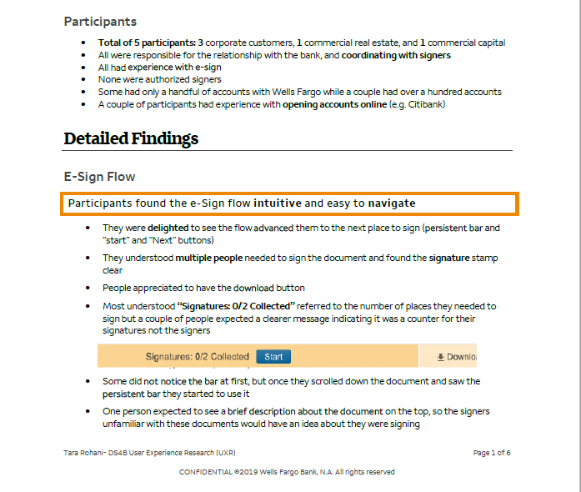
Findings
Customers thought it was intuitive and paid lots of attention to message bar area for instructions
Liked that button triggered next signature field; liked the guidance because they felt assured they wouldn’t miss a signature box

Slide 8
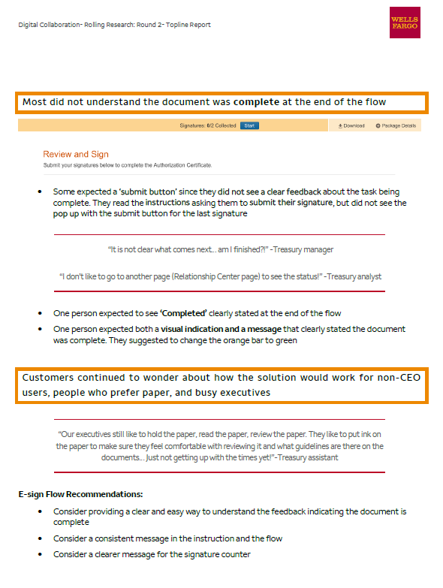
Where We Go From Here…

Slide 9
Special Thanks to
Gabi Itzler, Amy Egner, Tara Rohani, Annie Wang, Gauri Malhotra, Hemanth Madhusudhanan, Karen J, Betsy Lyon

