Slide 1
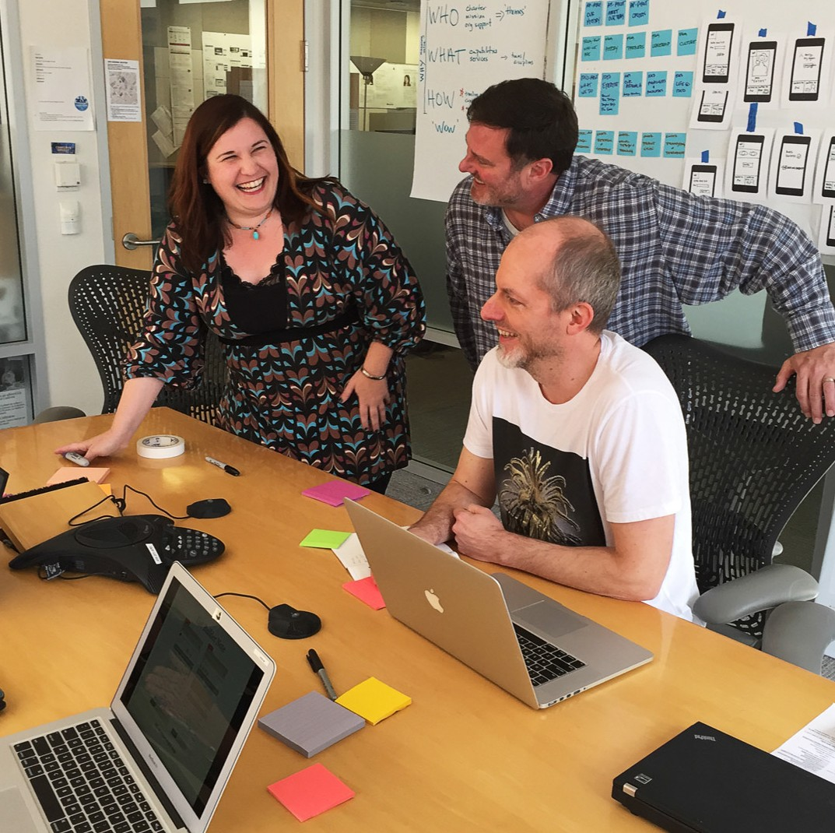
Customer Insights & Experience Design (CIXD)
We humanize commercial online banking, helping
our customers feel confident and productive in their work.
0

Slide 2
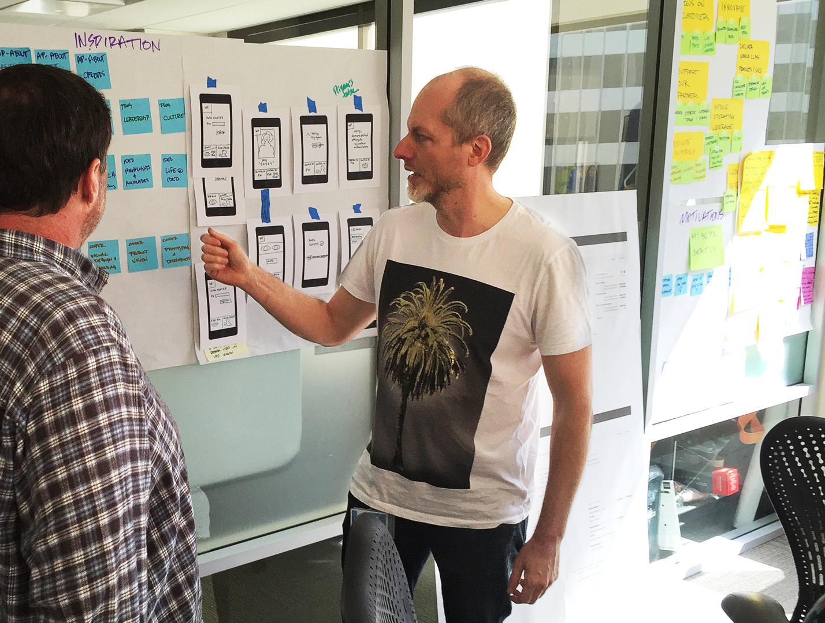
CIXD
We are a key partner in product development for CEO®, Gateway, and Wholesale digital platforms.
1

Slide 3





CIXD helps partners…
Transform business objectives and customer needs
2

Slide 4





CIXD helps partners…
Leverage technology to create effective digital environments
3

Slide 5


CIXD helps partners…
Deliver intuitive, confidence–inspiring user experiences
4

Slide 6

CIXD Practices
User-centered design
5

Slide 7


User-centered design
is a structured, systematic approach to achieving customer experience excellence.
“You can use an eraser on the drafting table or a sledge hammer on
the construction site.”
– Frank Lloyd Wright
6

Slide 8
How CIXD works
Make the right thing
Make the thing right
Sketch concepts and engage team
Document business cases
Initial idea
Design user interface
Build and pilot
Kickoff
Launch
Evaluate and iterate
7

Slide 9


User-centered design…
Builds alignment and engagement
8

Slide 10
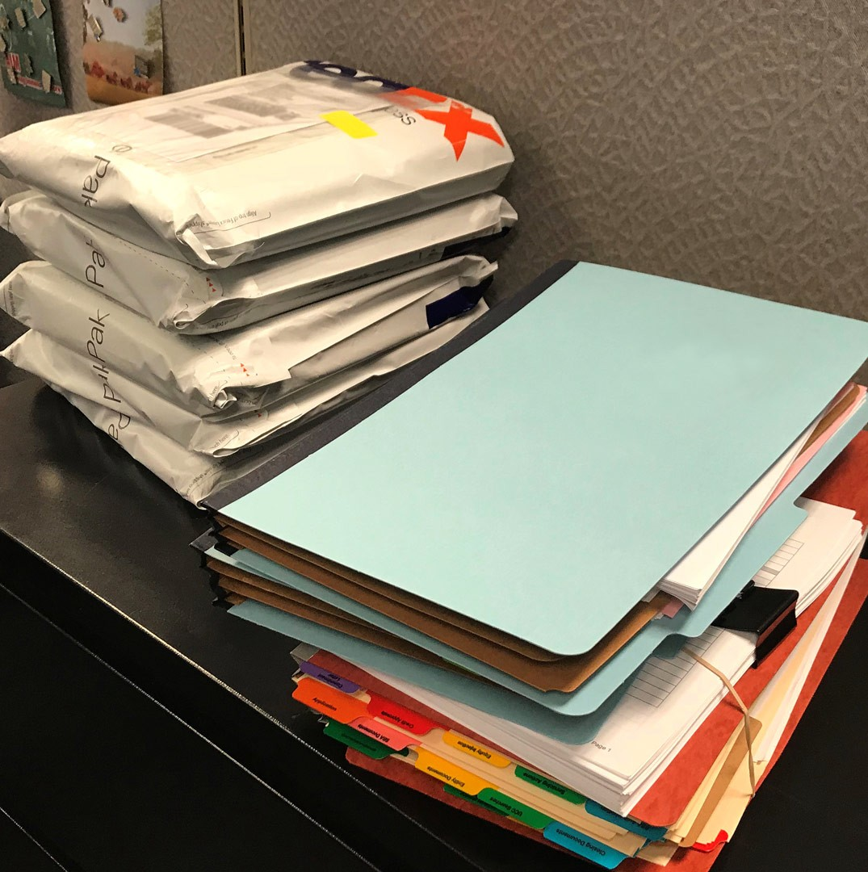
Before: paper-based systems weighed heavy on team members
and customers.
We disrupted the paper-intensive loan
process for our Business Development Officers in
Wholesale lending.
9

Slide 11
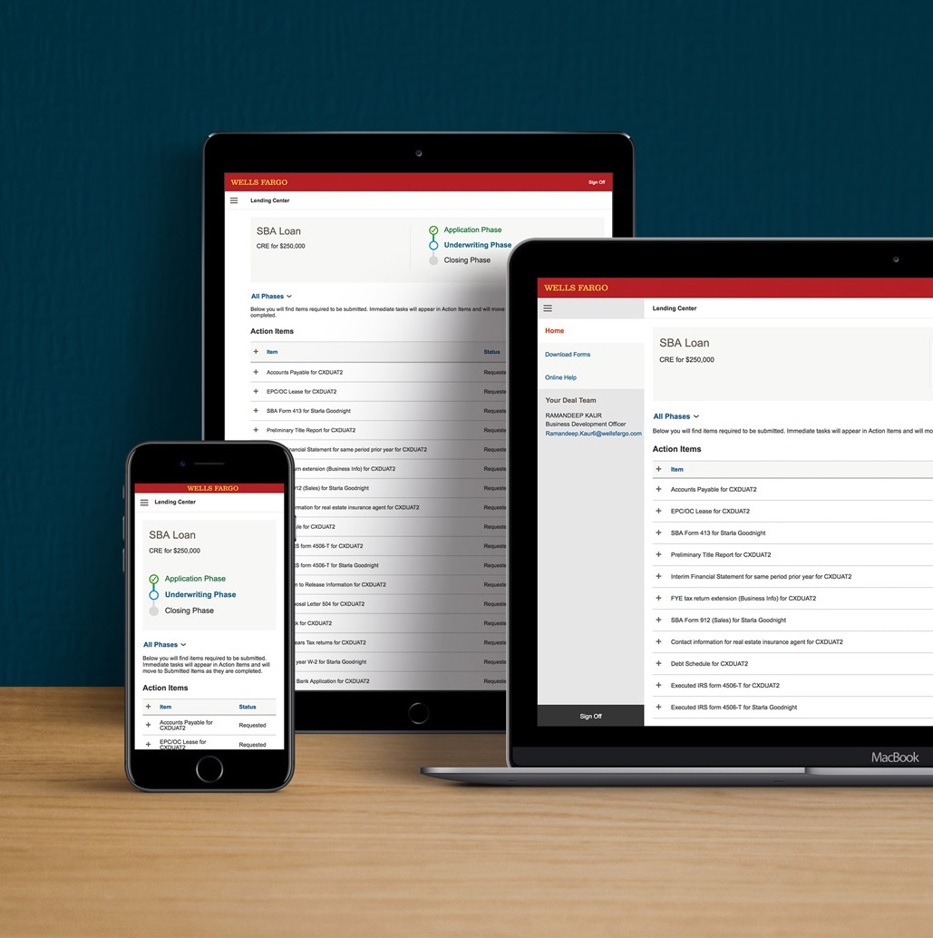
After: a digital experience increases efficiency and transparency.
We created a digital document exchange portal where customers get full visibility into a loan application.
10

Slide 12



User-centered design…
Lowers risk
11

Slide 13

Before: forgetting a password was the #1 cause of customer support calls.
To reduce password pain, we sought out an easier and secure sign-on process.
12

Slide 14
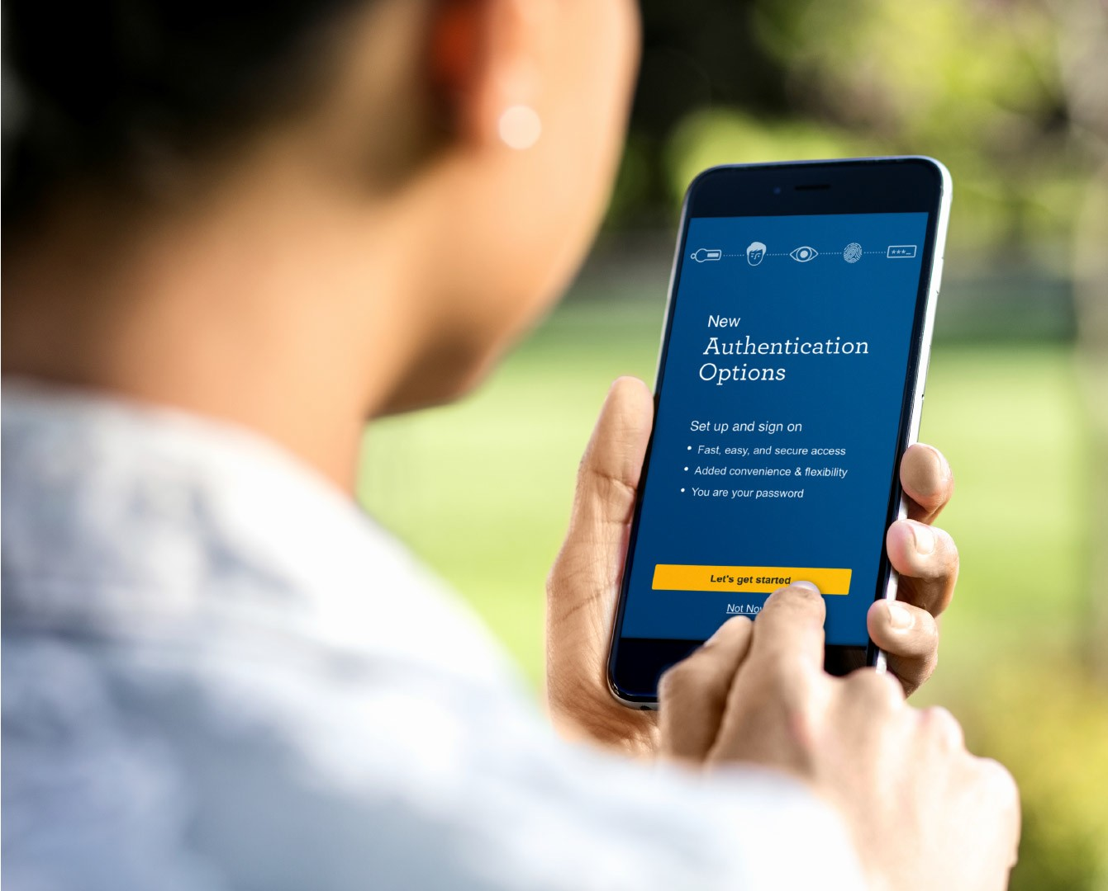
After: the person is the password with new mobile authentication options.
Biometric sign-on features like Touch ID, Face ID, and Eyeprint give faster and more convenient access.
13

Slide 15






User-centered design…
Shifts culture
14

Slide 16

Before: software developers wanted an easier way to embed our offerings into their systems.
To keep up with tech-savvy customers, we created APIs to simplify the process of enabling data and payments services.
15

Slide 17
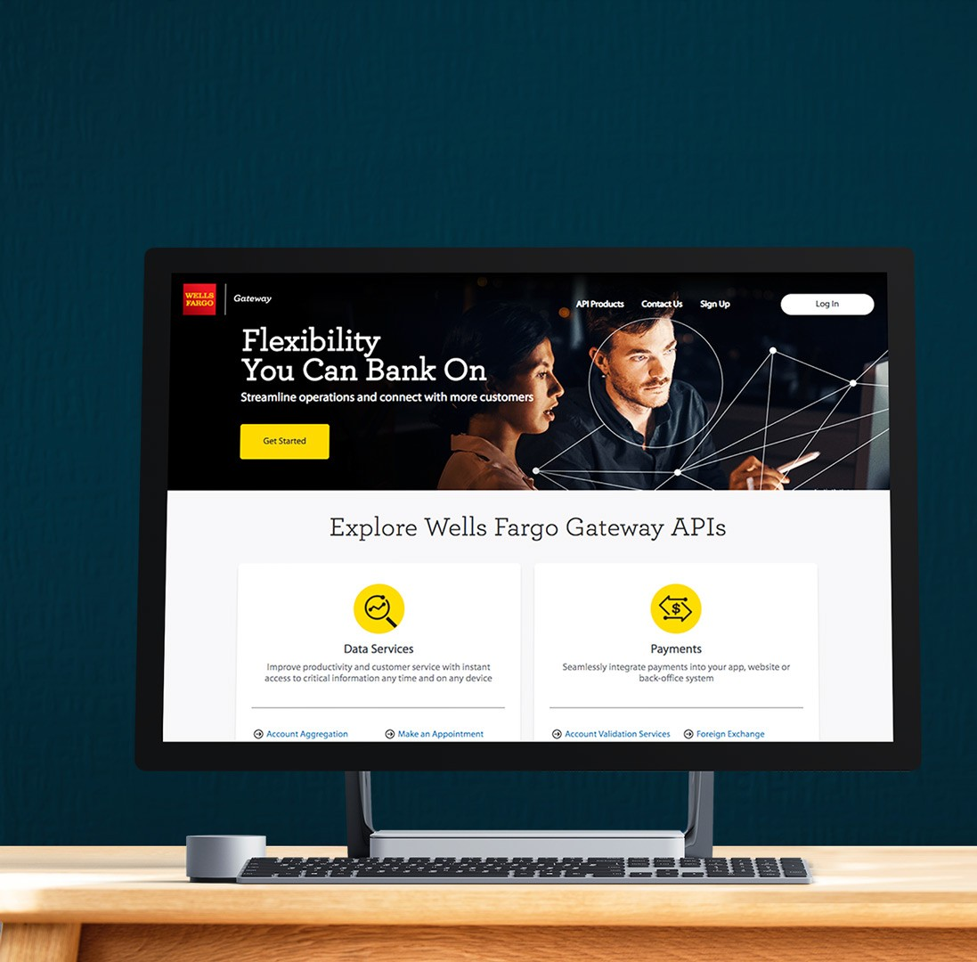
After: an integrated experience offers a smarter way to work.
From testing data in the Sandbox, to hands-on guidance with code launch, the Gateway API portal equips customers with easy-to-use resources.
16

Slide 18


Great design puts customers first, from
concept to production.
— Robin Beers SVP, Customer Insights & Experience Design
17

Slide 19



From paper to pilot
Methods for testing concepts with customers.
Advisory council
Customer discussions to learn about pain points, opportunities, and get feedback on early concepts.
Ethnography
Observing customers in their own environments to understand behaviors and efficiencies.
User research
Customers provide feedback on design concepts and interactive prototypes.
Product pilot
Gathering input after customers try out a product with their own data and systems.

Slide 20









Experience strategy offerings
Rapid prototyping
Persona creation
Journey mapping

Slide 21

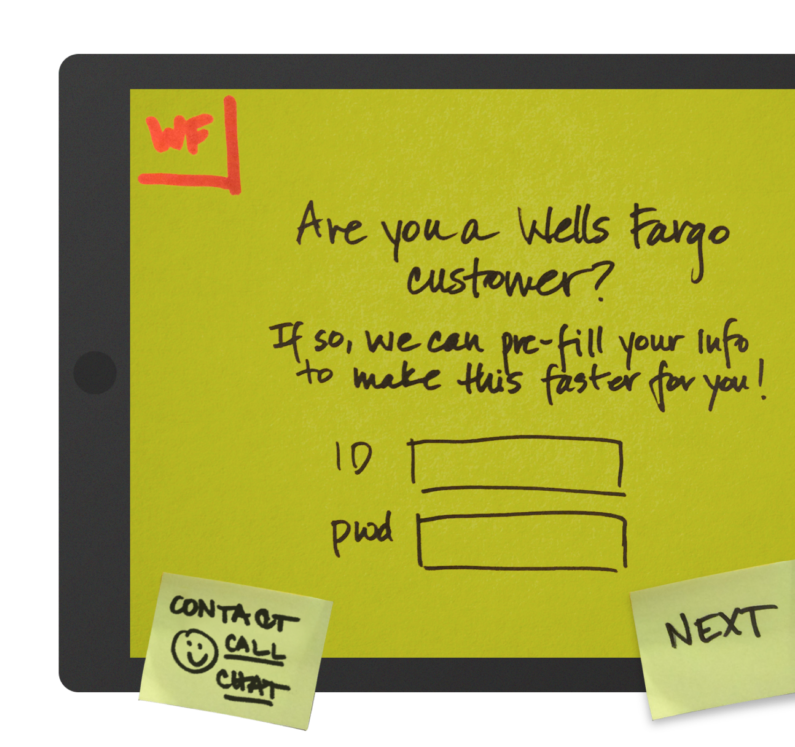




Rapid prototyping
20

Slide 22

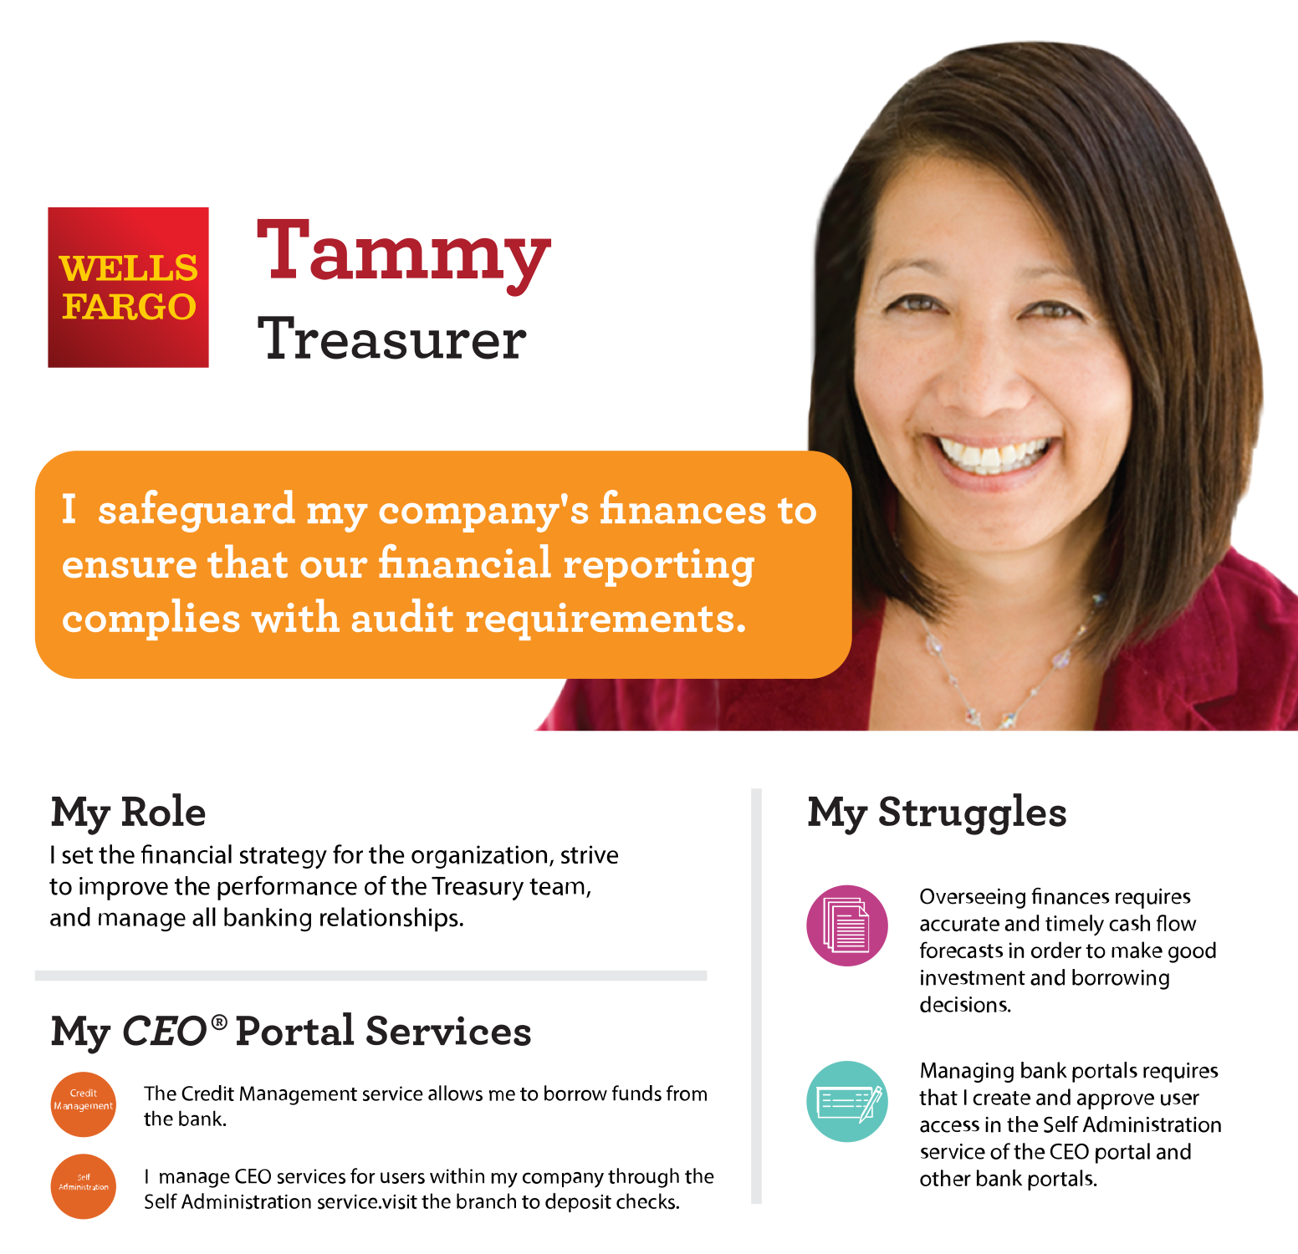





Persona creation
21

Slide 23
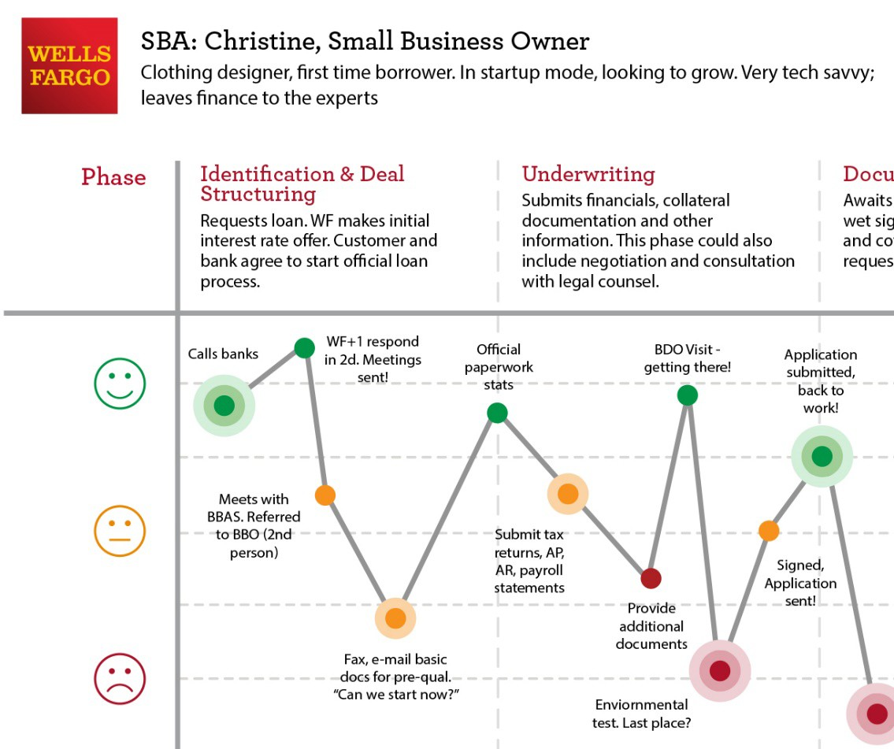





Journey mapping
t
22

Slide 24


http://hop.hosting.wellsfargo.com/cixd
© 2019 Wells Fargo Bank, N.A. All rights reserved. Internal use only.
23

